Slide 1

Samsung GOt Talent
Activity 1

Slide 2
MECHANICS
SKills assessed: WIRING,JAVACONFIG,SpEL
Download ‘repository-act1.zip’. Unzip to dir: <user_home>/clp/
cd to <user_home>/clp/repository/
Copy everything from <user_home>/clp/repository/ to <user_home>/.m2/repository/
Download ‘samsung-got-talent-act1.zip’
Unzip the downloaded file to dir: <user_home>/clp/

Slide 3
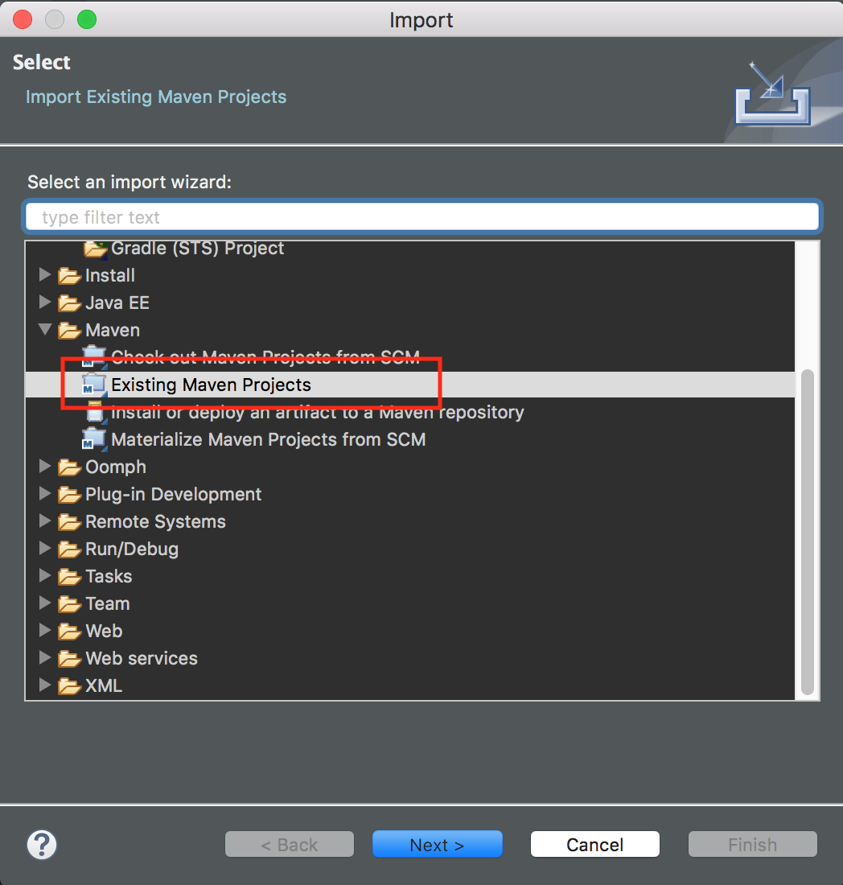
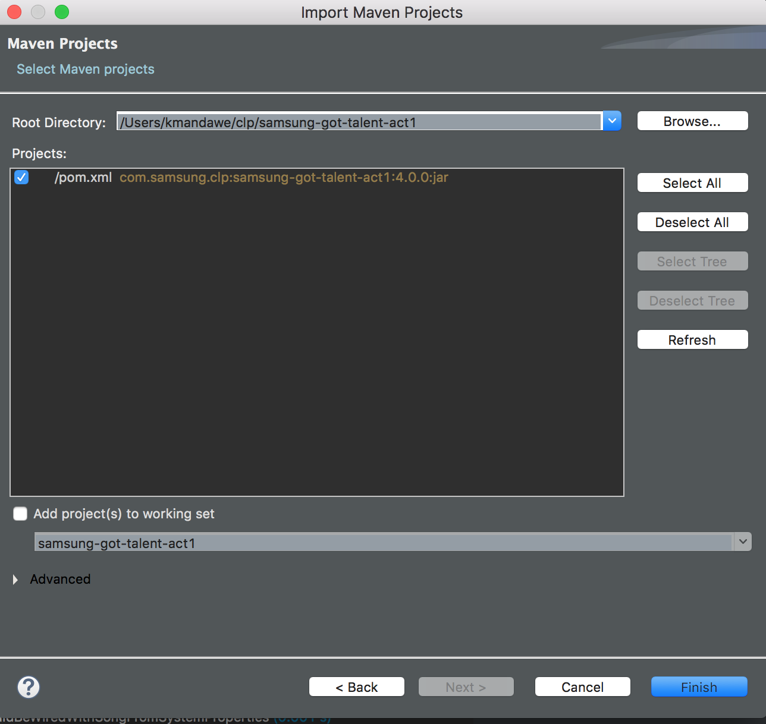
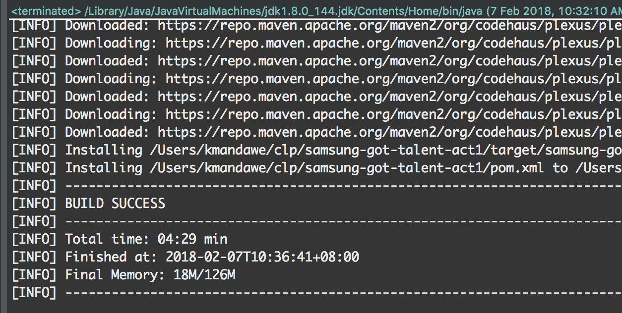
6. In your STS, import as existing maven project:
7. Open pom.xml. Right-click -> Run as -> Maven Install. Wait for the build to finish. The expected result would be similar to below:

Slide 4
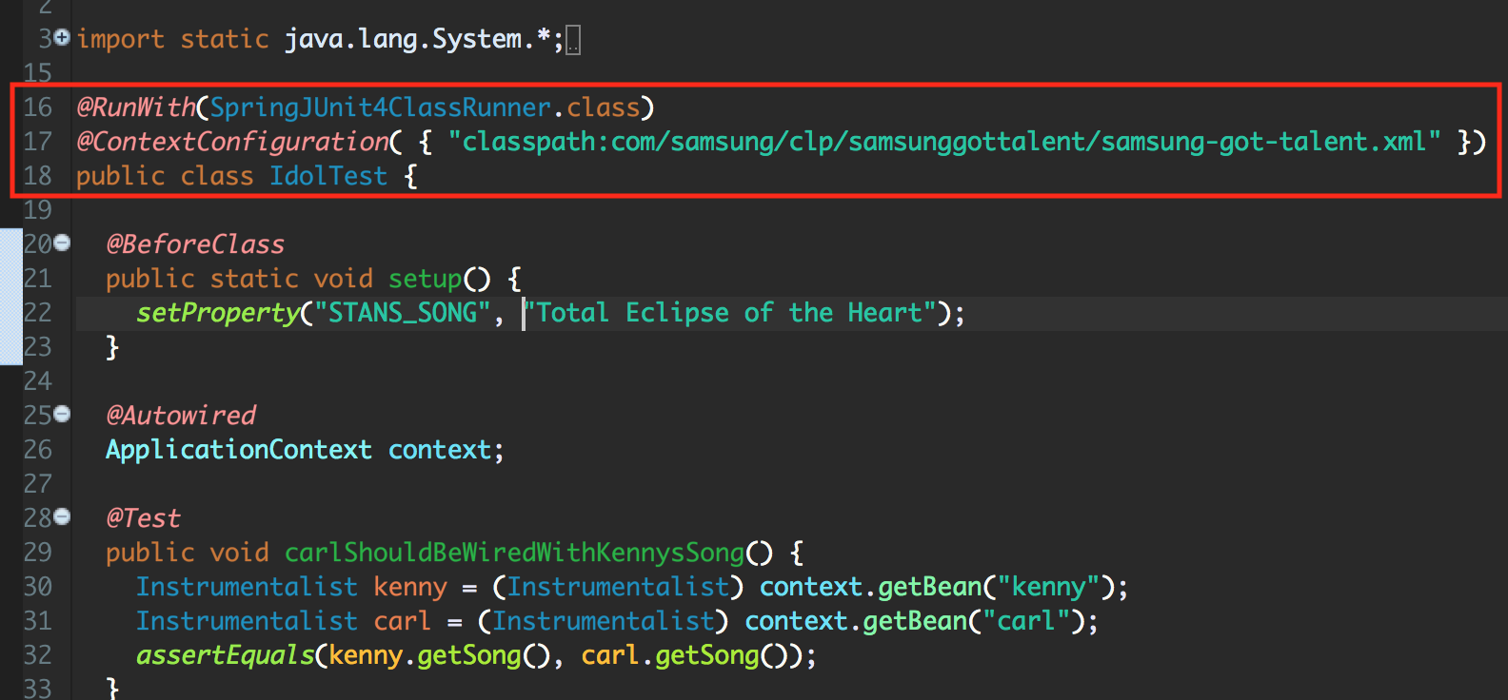
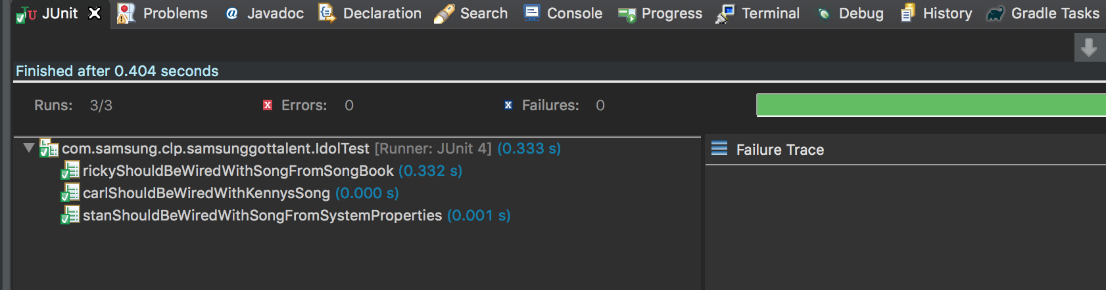
8. Open IdolTest.java. Take note that this is using XML configuration. See line 17.
9. On the package explorer right-click on IdolTest.java -> Run as -> Junit test. Expected result would be:

Slide 5
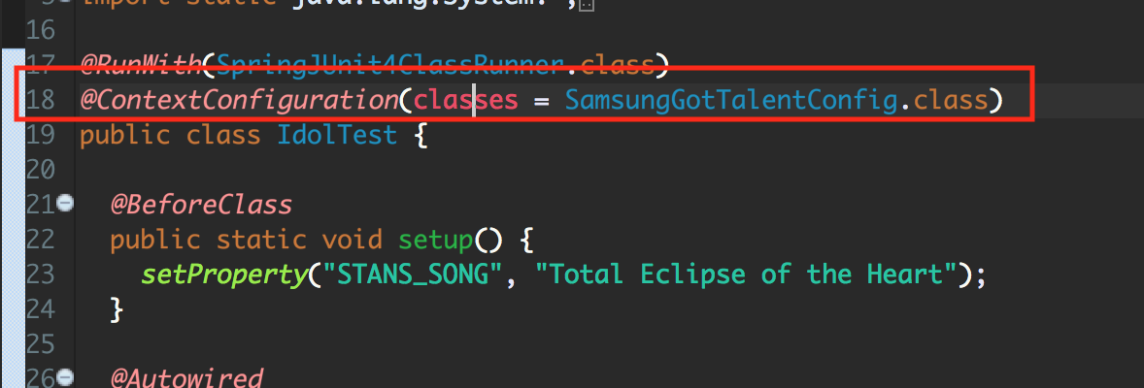
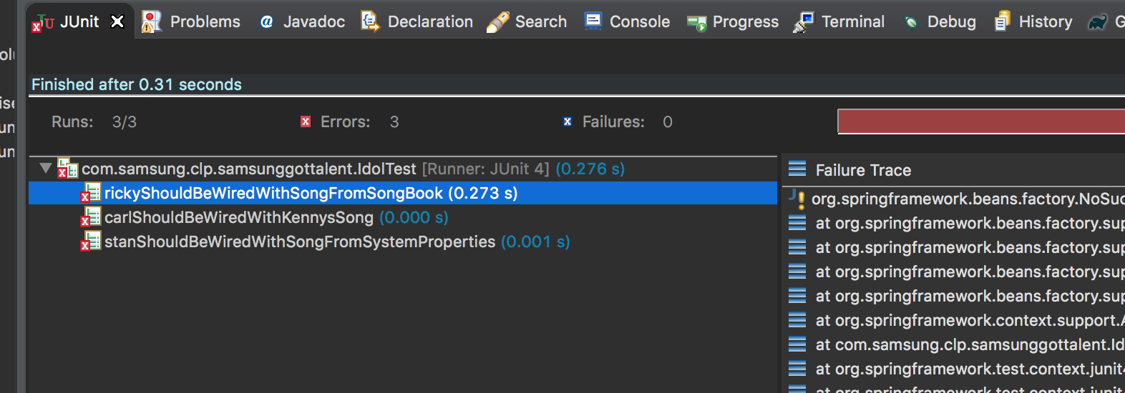
10. Carefully inspect the three test cases in IdolTest.java. Understand how the beans were created by inspecting ‘samsung-got-talent.xml’.
11. Transform the configuration from XML to JavaConfig. Change Line 17 of IdolTest.java to load JavaConfig instead of XML config by doing similar to below:
12. Run JUnit test again. The expected behavior is all 3 test cases would fail:

Slide 6
13. The goal is to make the three test cases pass again. The only change allowed in IdolTest.java is loading JavaConfig instead of XML config (step 11). Hint: Open SamsungGotTalent.java. The first performer named ‘kenny’ is already done for you.
14. The approach should be transforming samsung-got-talent.xml to an equivalent JavaConfig: SamsungGotTalent.java. All beans should be created on that JavaConfig file.
15. When done, zip your project following the name format: clp_act1_<lastname>_<firstname>.zip.
16. Upload the zip file to:

